Slide 1
In watter jaar het die volgende gebeur???

Slide 2

Reality TV
2001

Slide 3
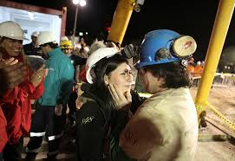
Chile mynwerkers na 69 dae gered?
2010

Slide 4
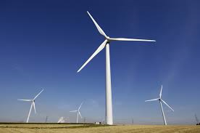
1ste wind terbune in SA?
2010

Slide 5
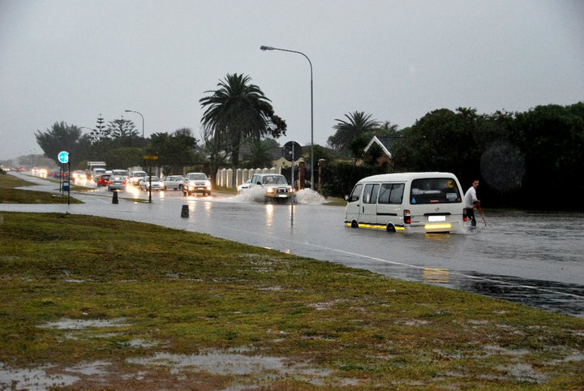
Flash floods in Port Elizabeth?
2012

Slide 6
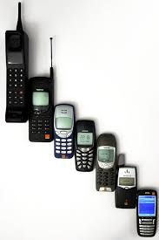
1ste cellfoon in SA?
2007

Slide 7
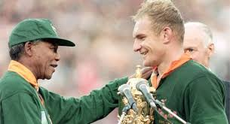
SA 1ste keer die wereldbeker gewen?
1995

Slide 8
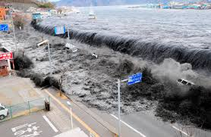
Fukushima taunami / aardbewing?
2011

Slide 9
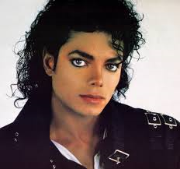
Michael Jackson oorlede?
2009

Slide 10
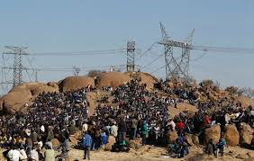
Marikana slagting???
2012

Slide 11
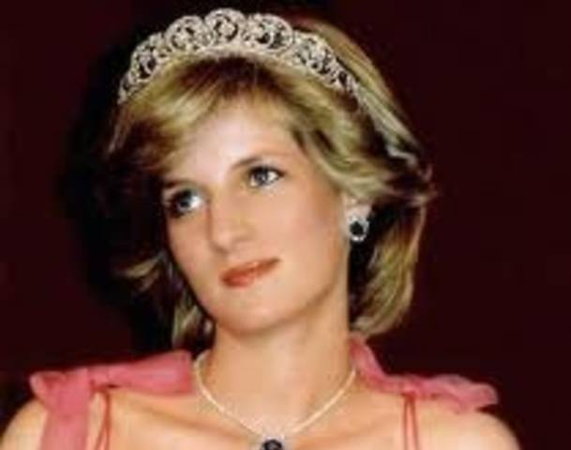
Lady Diana oorlede?
1997

Slide 12
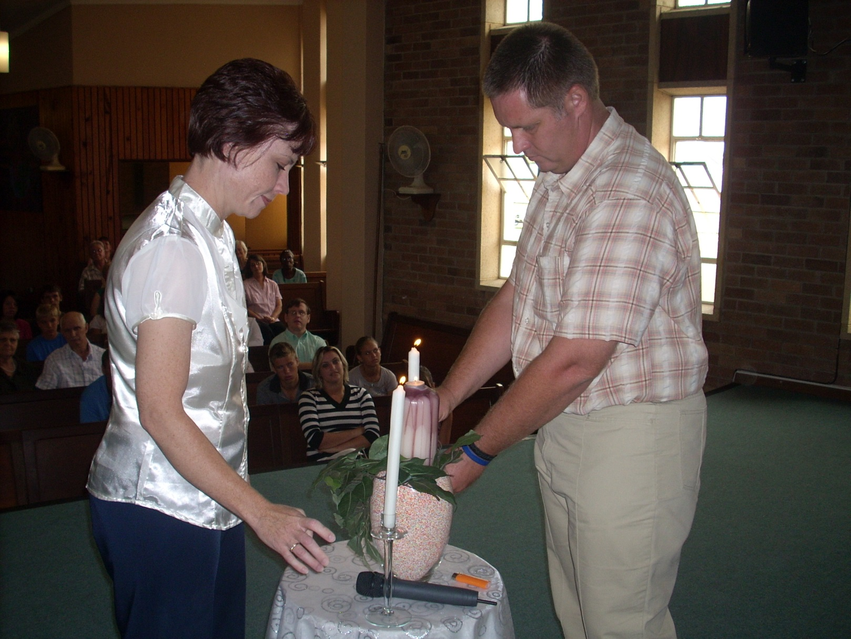
Eldre permanent by die kerk begin werk?
2006

Slide 13
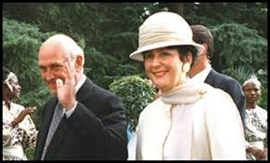
FW de Klerk se vrou Marike vermoor?
2001

Slide 14
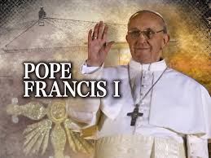
Pope Francis aangestel?
2013

Slide 15
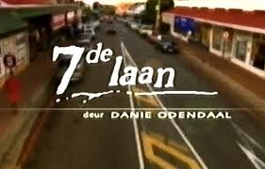
7de Laan begin?
2000

Slide 16
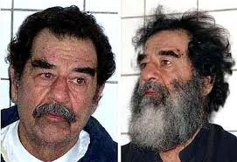
Saddam Hussein onttroon?
2003

Slide 17
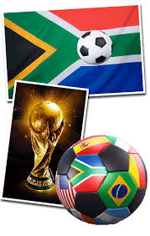
Sokker wereldbeker in SA?
2010

Slide 18

DSTV in SA begin?
1995

Slide 19
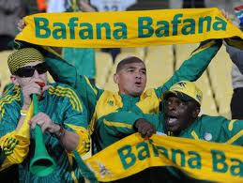
Bafana Bafana hulle 1ste wedstryd gespeel?
1992

Slide 20
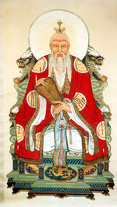
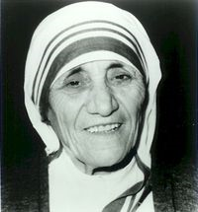
“The bad news is time flies. The good news is you're the pilot." -”
― Michael Altshuler
“Time is a created thing. To say 'I don't have time,'
is like saying, 'I don't want to.”
― Laozi
“Yesterday is gone. Tomorrow has not yet come. We have only today. Let us begin.”
― Mother Teresa

