Slide 1
REAL or FAKE?

Slide 2
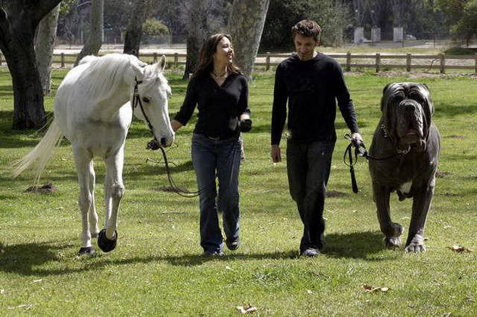
FAKE

Slide 3
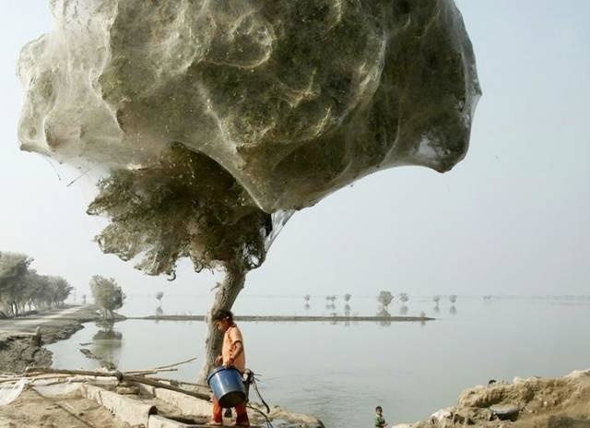
Spiders climbed trees to avoid flooding in Pakistan. Thousands of them ended up building webs there.

Slide 4
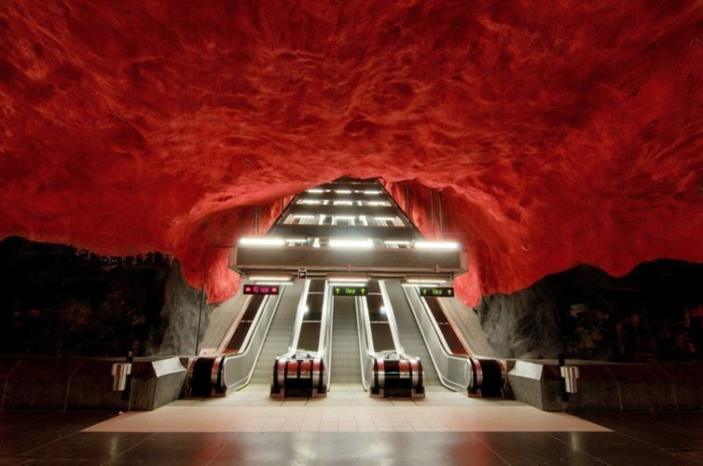
The Solna Centrum subway station in Stockholm looks like the escalator to hell

Slide 5
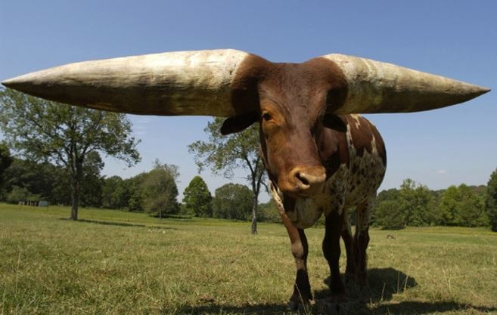
The largest steer horns in the entire world

Slide 6
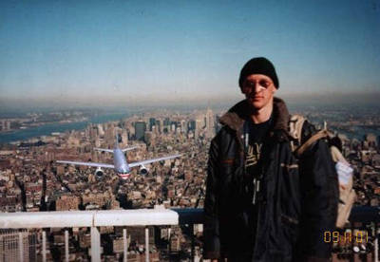
FAKE

Slide 7
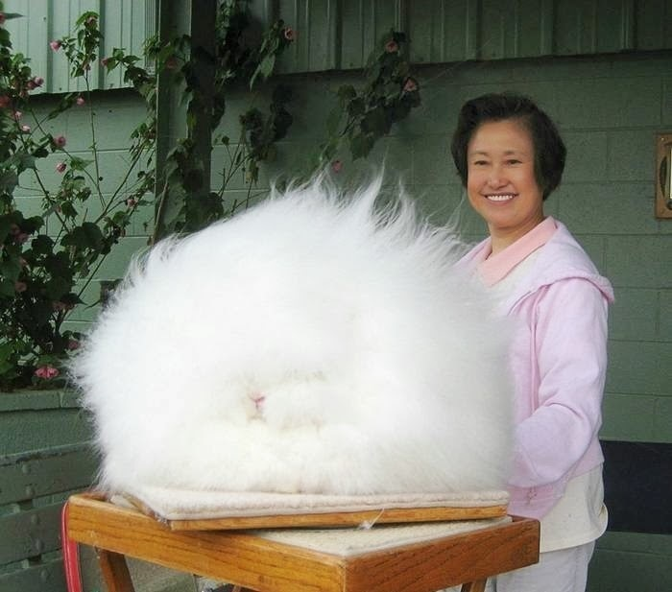
The world’s fluffiest bunny - he's somewhere under there, we promise.

Slide 8
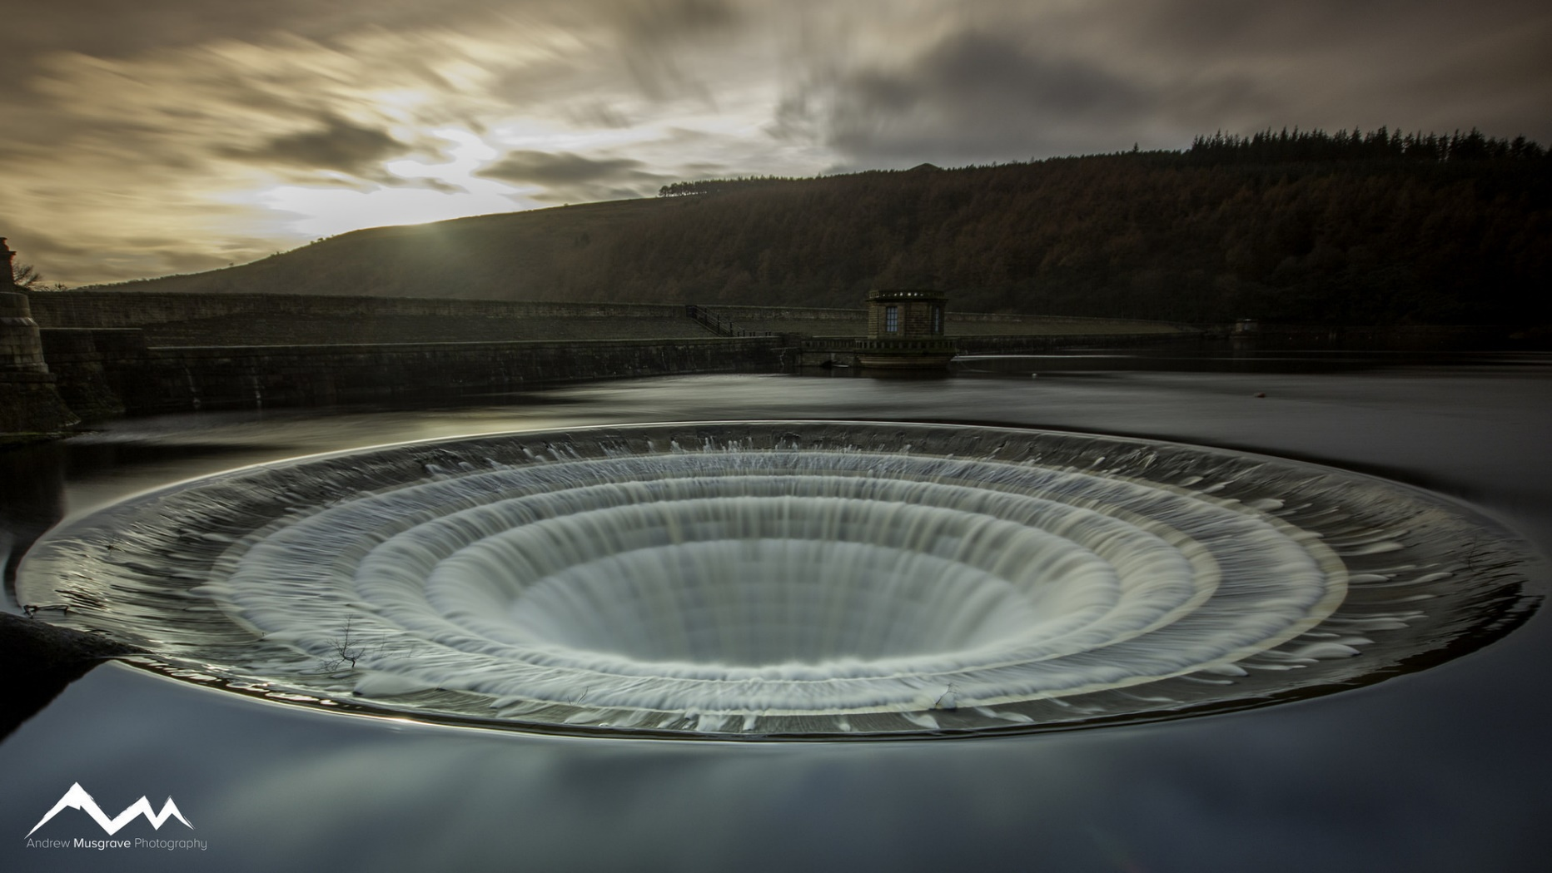
The plughole at the Ladybower Reservoir in the UK. The hole is actually man-made to prevent the dam from flooding

Slide 9
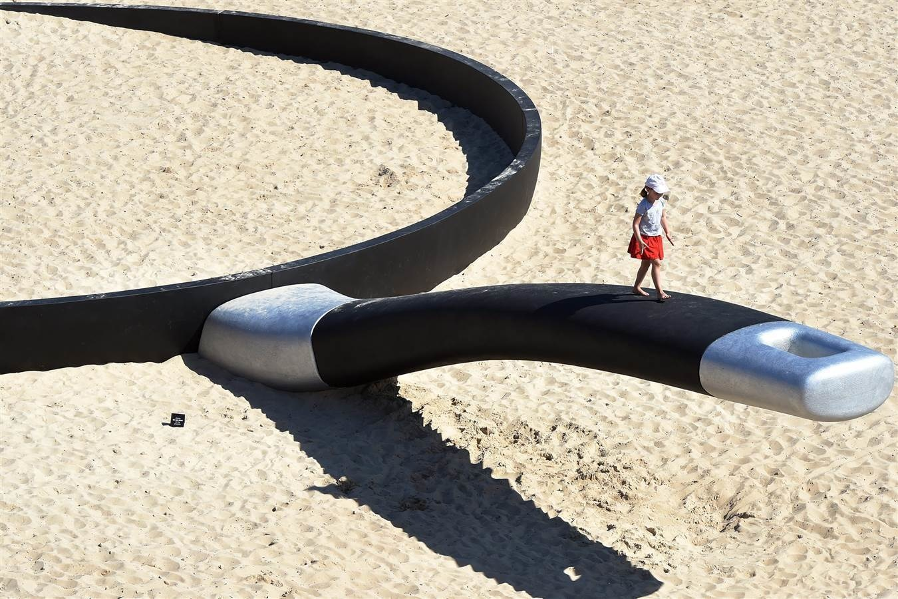
A Frying pan beach sculpture in Sydney, Australia.

Slide 10
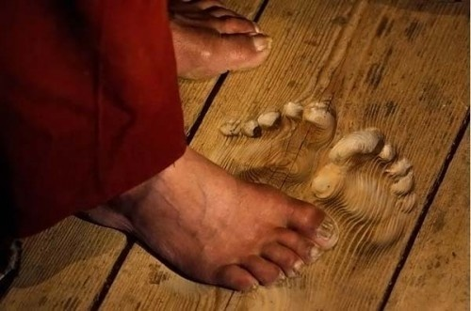
Wood that got so warm and soft, it literally melted.

Slide 11
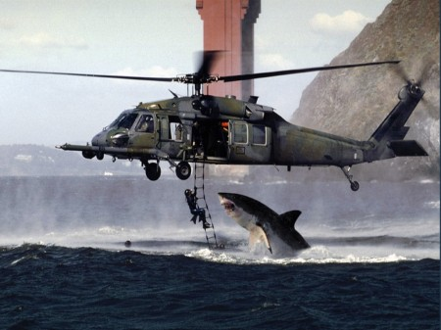
FAKE

Slide 12
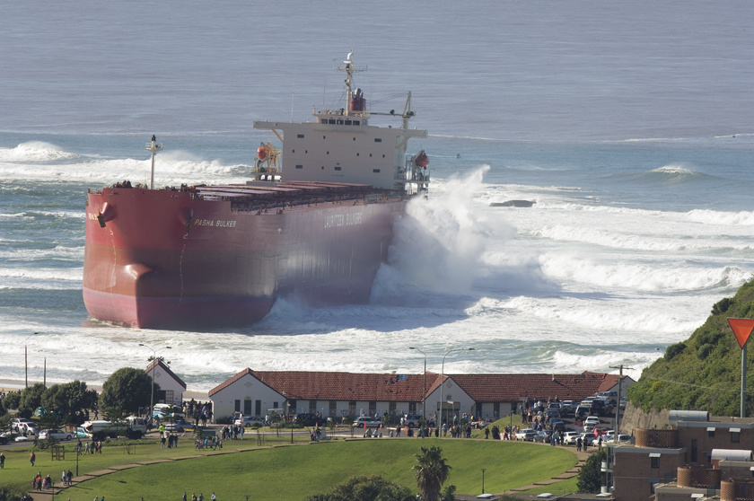
A ship that nearly crashed it's way into this picturesque village.

Slide 13
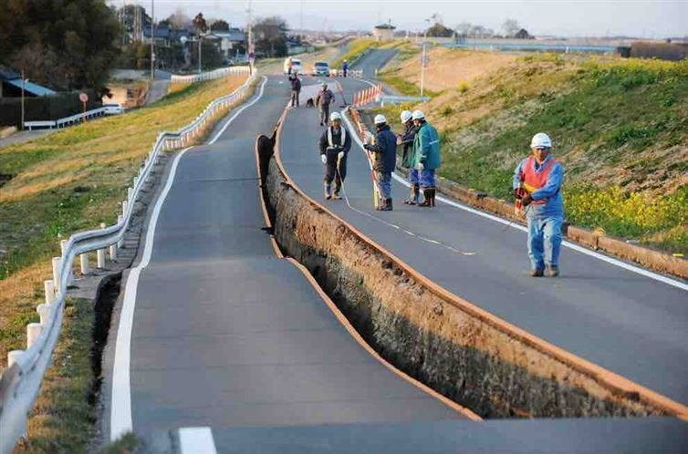
A road that exists on two separate levels.

Slide 14
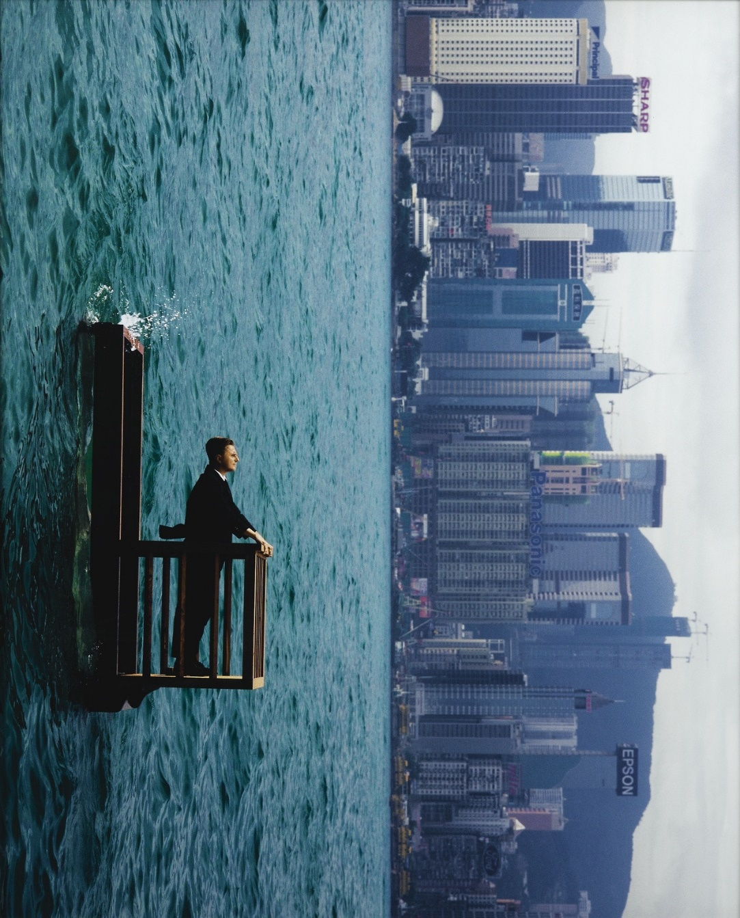
FAKE

Slide 15
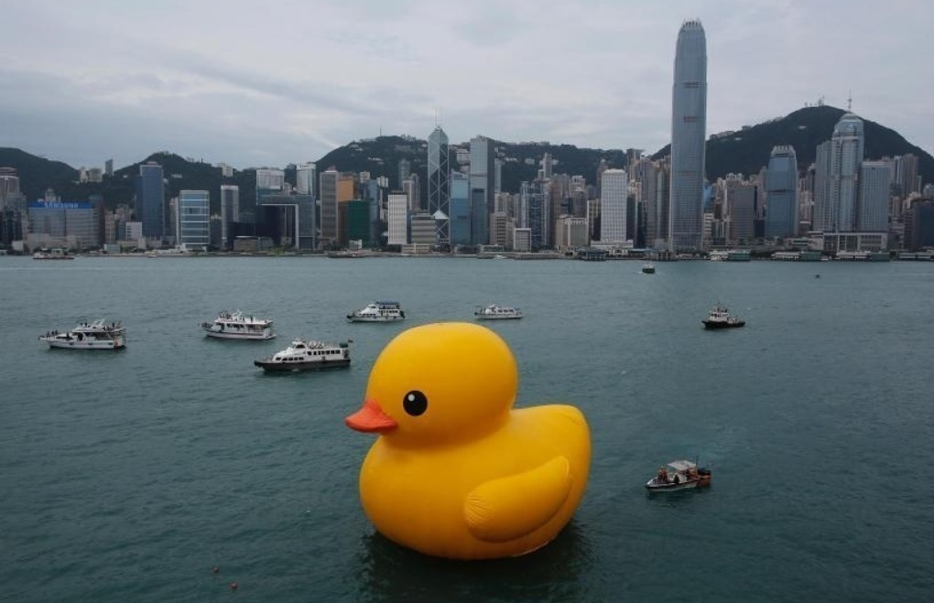
A massive rubber ducky in a city river.

Slide 16
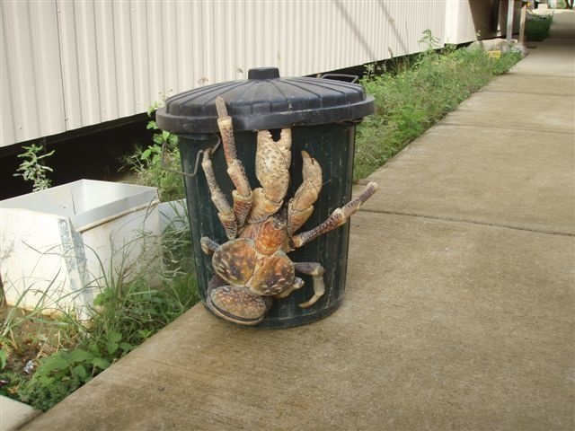
These enormous coconut crabs are a common sight in tropical climates.

Slide 17
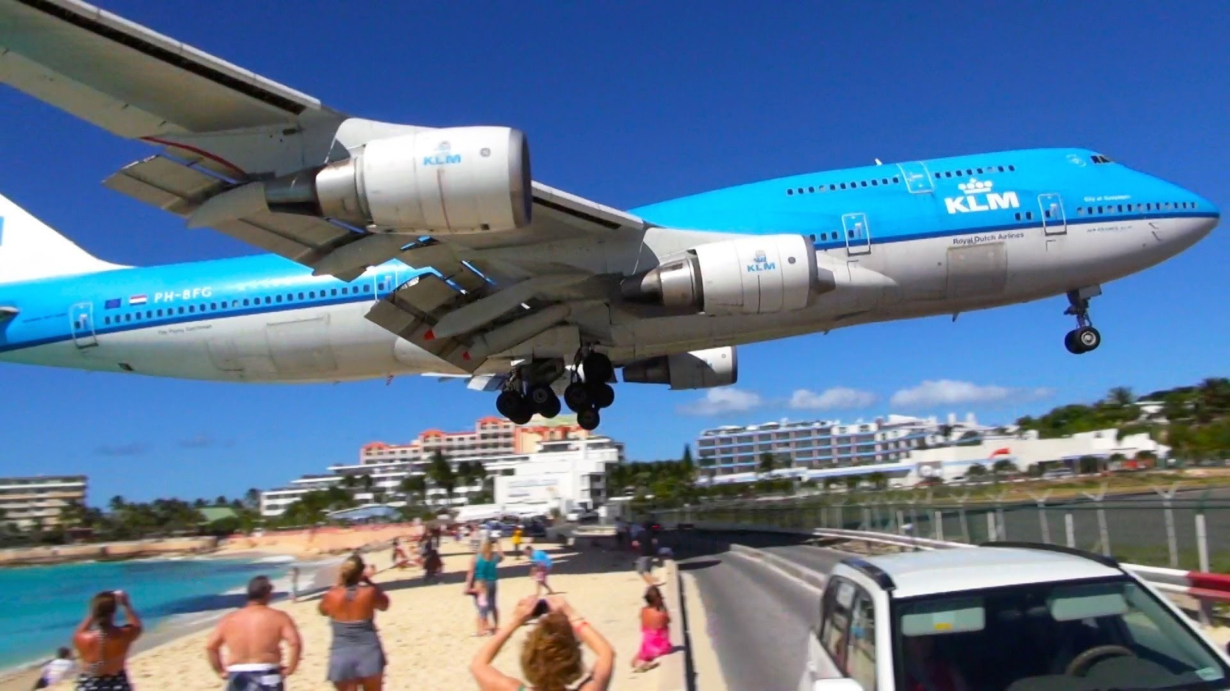
An airplane coming in for a landing at St. Maarten airport.

Slide 18
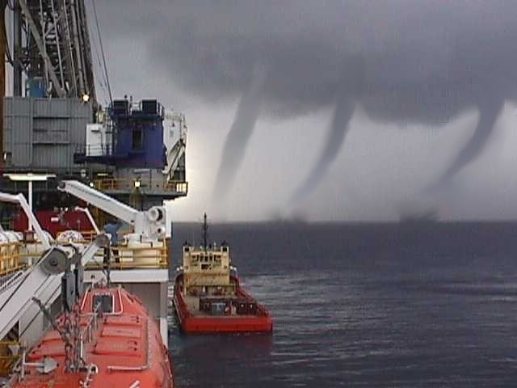
FAKE

Slide 19
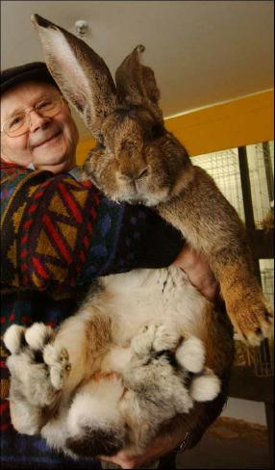
This is Herman he is 43cm on all four feet, he weighs about 8 kg, and he can stand over 92cm tall on his back legs.

Slide 20

A cat with a half-and-half face.

Slide 21
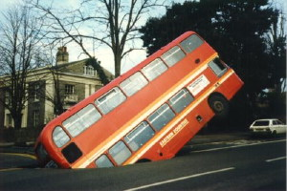
FAKE

Slide 22
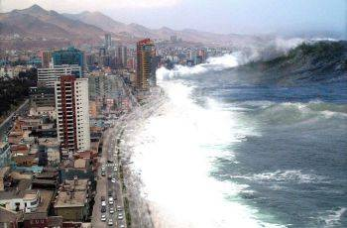
FAKE

Slide 23
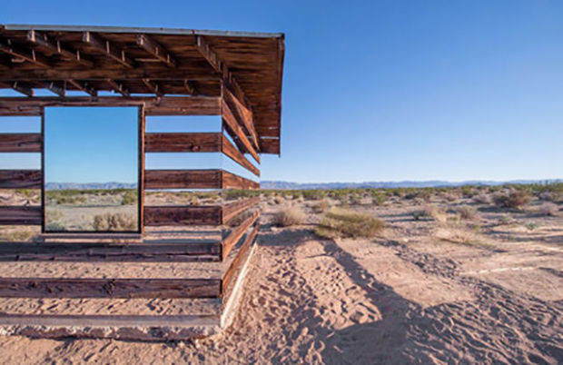
This awesome wooden shelter that sits in the California High Desert uses mirrors and light to create a small house full of awesome

Slide 24
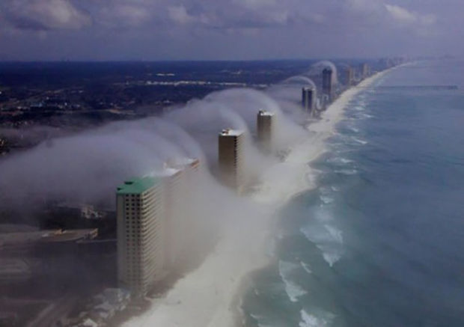
It might look like a tsunami but it's actually a condo wave forming along the coast of Florida over the beaches of Panama City

Slide 25
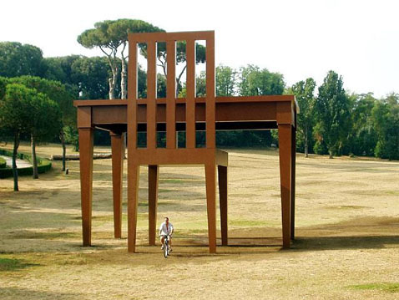
10 meter tall Chair and Table in London England

Slide 26
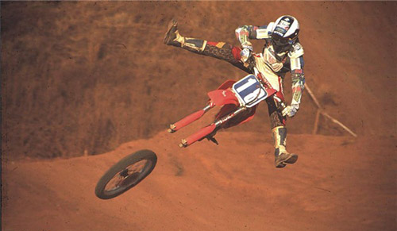
FAKE

Slide 27
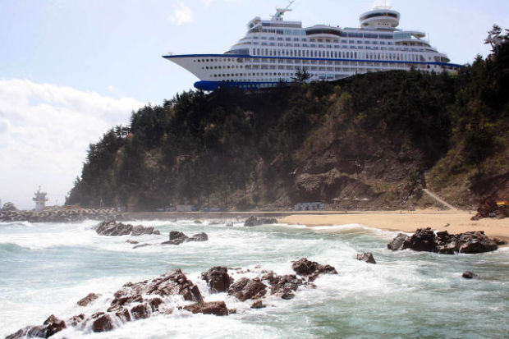
This is actually a hotel that is designed to look like a cruise ship in South Korea.

Slide 28
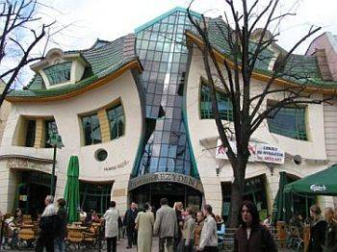
The Crooked House in Poland. It is based off the fairytale of Hansel and Gretel.

Slide 29
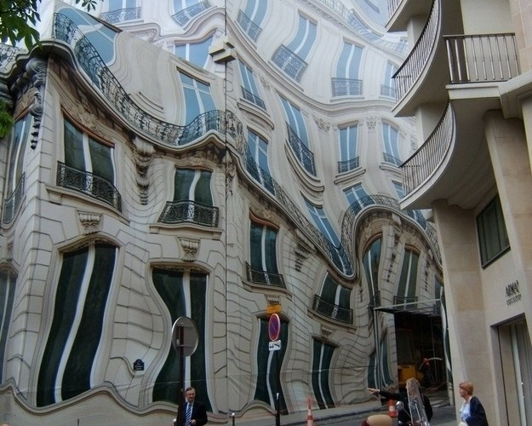
FAKE

Slide 30
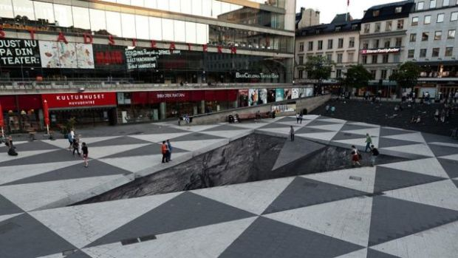
FAKE

Slide 31
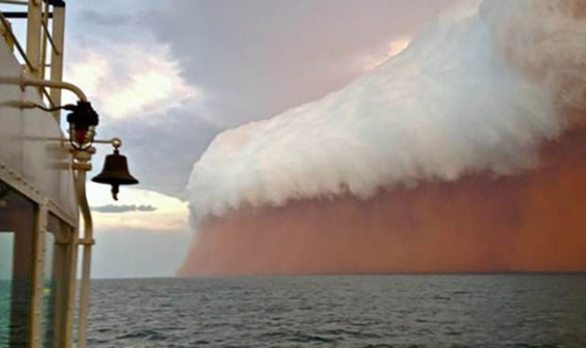
Known as an Arcus cloud, it looks like a wall of pink glorious marshmallow

Slide 32
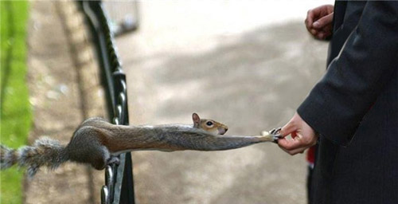
FAKE

Slide 33
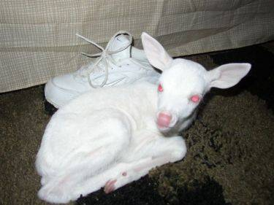
This is an albino deer found in the USA in the state of Wisconsin.

