Slide 1


Happy Family

Slide 2

Love Song

Slide 3


Bow and Arrow

Slide 4


Snow Queen

Slide 5


Smoking Hot

Slide 6
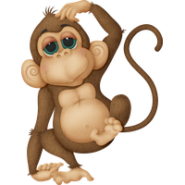

Monkey Business

Slide 7


City of Angels

Slide 8


Cow Boy

Slide 9


Bomb Shell

Slide 10

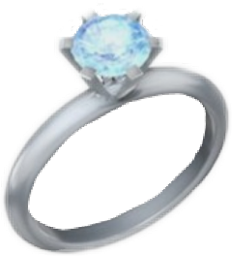
Keyring

Slide 11

Hot Dog

Slide 12


Sunlight

Slide 13

Bad Hair Day

Slide 14

Paint Ball

Slide 15


Sunflower Oil

Slide 16


Bookworm

Slide 17

Smoking gun

Slide 18

Radio Silence

Slide 19


Scroll Down

Slide 20


IPhone

