Slide 1
Alpha: Sessie 2 – Wie is Jesus?
Ysbreker: Famous People

Slide 2
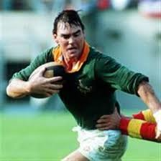

Slide 3
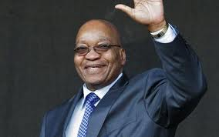

Slide 4
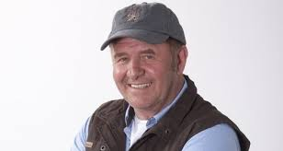

Slide 5
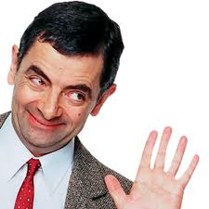

Slide 6
